Slide 1
Final Project Google Play Store Apps
Group Epsilon
Group Members:
Maryam Heidari, Thi Thai Ngan Le,
Raviteja Vakkanthula, Findlee Odili-Obi
ALY6015- Intermediate Analytics [CRN: 80797]
Professor: Prof. Valeriy Shevchenko 12 May 2019
Northeastern University

Slide 2
Outline
Introduction
Analysis Questions and Methods Used
Cleaning of Dataset
Structuring and Clustering of Dataset
Linear Regression
Summary and Conclusion
References

Slide 3
Introduction
Google Play Store Apps from Kaggle
10841 rows, 13 variables
2 billion monthly active devices on Android
Benefits new and existing application developers. Existing applications can update to new trends
Variables used are;
App: Application name - It is a Factor variable
Category: It is a categorical variable with 33 categories.
Rating: Overall user rating of the app. It is a continuous variable
Reviews: Number of user reviews for the app. It is a continuous variable
Installs: Number of user downloads/installs for the app
Type: paid or Free. It is a categorical variable with 2 category which are paid or free
Price: Price of the app. It is a continuous variable

Slide 4

Analysis Questions
Analysis Methods
Which application is going to be successful in future and worth to investigate on it?
Do the variables in our dataset impact the number of Installs for any application in Play store?
Data Mining, Clustering techniques
Linear Regression

Slide 5
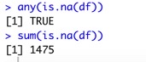
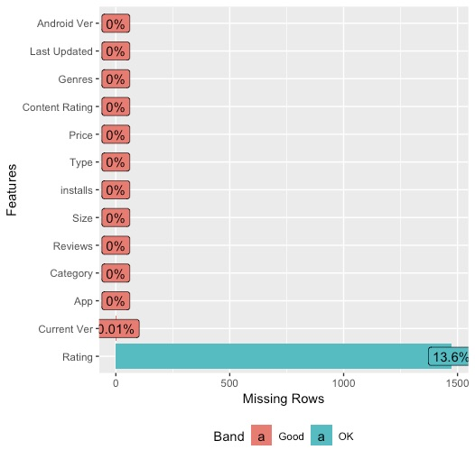
Cleaning of Dataset
Assumption: There is correlation between “Reviews” and “Ratings”
Rules:
Remove: NULL ”Ratings” that have ”Reviews” less than 10
Replace with zero: NULL “Ratings” that have ”Reviews” more than 10
Check for and remove duplicate rows

Slide 6
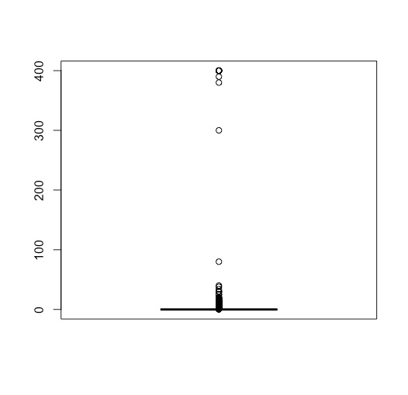
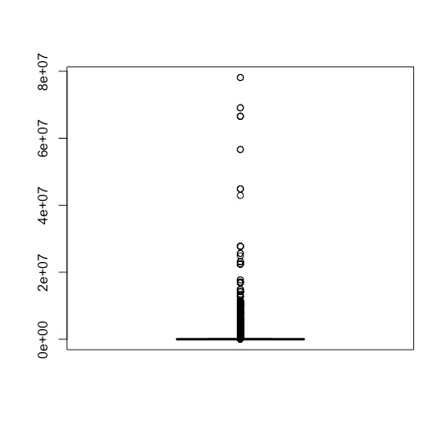
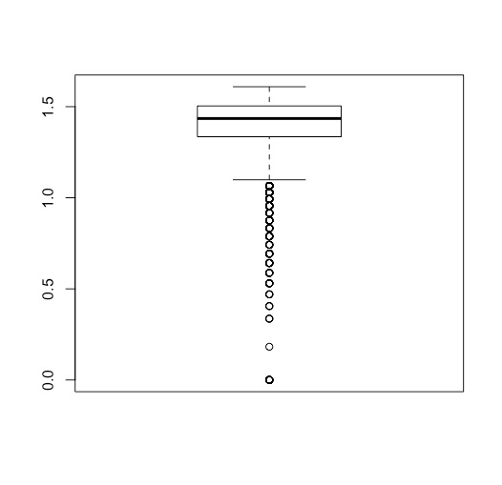
Removing outliers
Outliers has negative affects on accuracy of data set
Box plot for variables:
Price
Reviews
Installs
Ratings

Slide 7
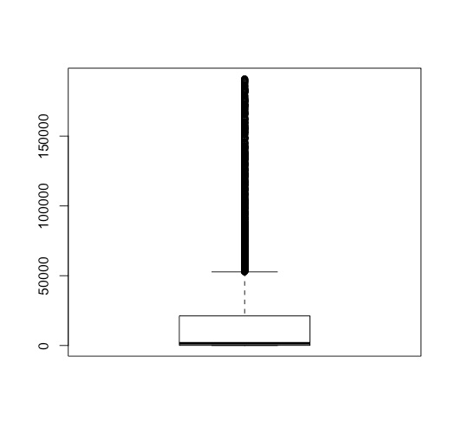
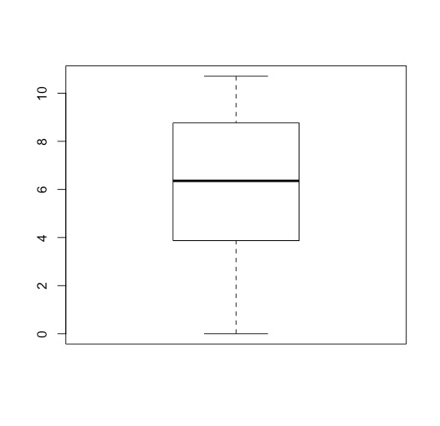
Removing outliers (cont’d)
Boxplot of Reviews
Log Boxplot of Reviews

Slide 8
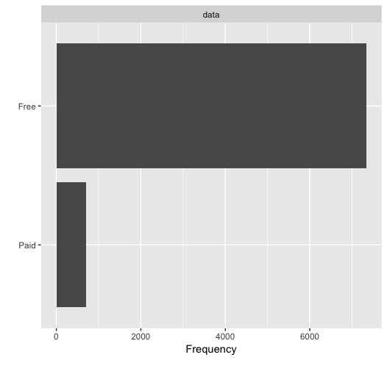
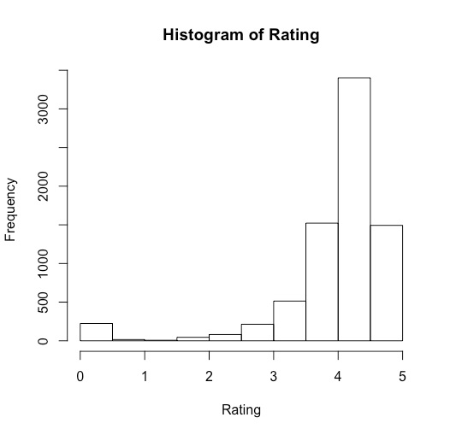
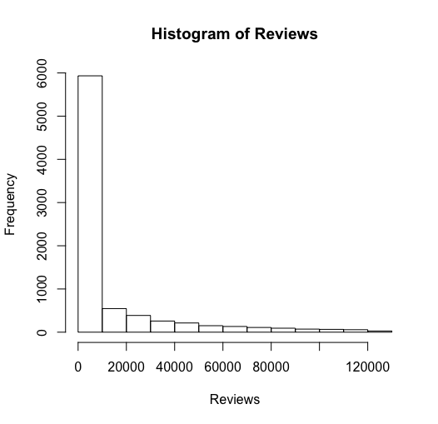
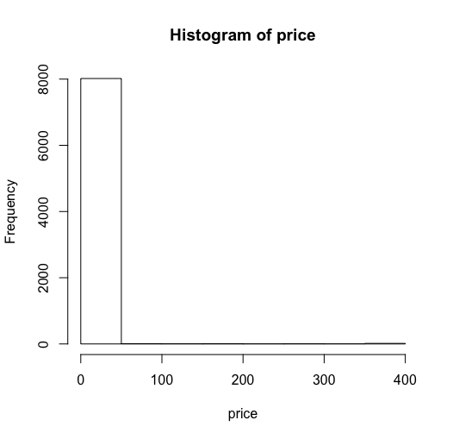
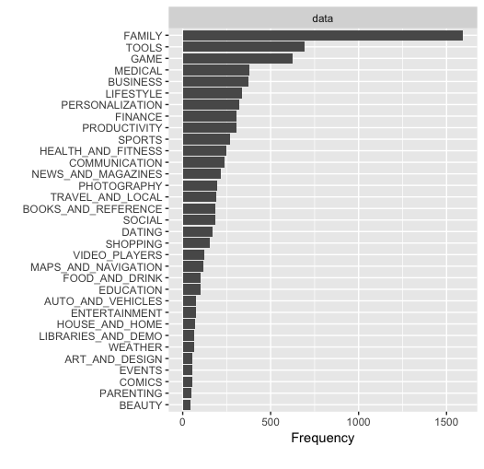
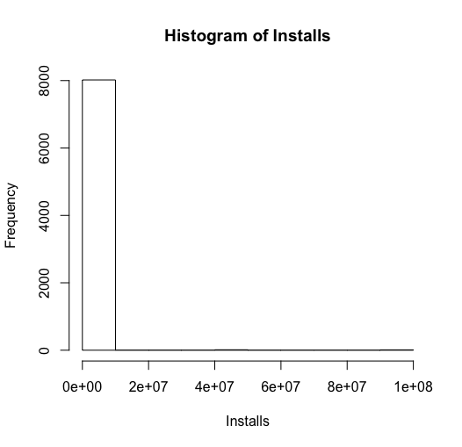
Exploratory data analysis
Rows: 7518, Column: 13
Variables: Rating, Reviews, installs, type, price, and categories

Slide 9
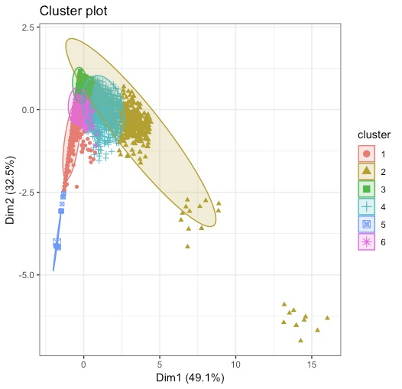
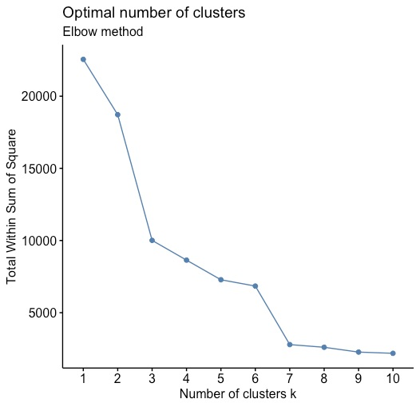
Clustering of Dataset

Slide 10
Clustering of dataset (cont’d)
 | 1 | 2 | 3 | 4 | 5 | 6
ART_AND_DESIGN | 2 | 0 | 28 | 4 | 1 | 22
AUTO_AND_VEHICLES | 8 | 1 | 28 | 4 | 1 | 29
BEAUTY | 1 | 1 | 16 | 3 | 6 | 21
BOOKS_AND_REFERENCE | 16 | 5 | 74 | 18 | 6 | 38
BUSINESS | 46 | 6 | 90 | 25 | 8 | 88
COMICS | 10 | 0 | 24 | 4 | 1 | 16
COMMUNICATION | 22 | 16 | 35 | 37 | 7 | 90
DATING | 34 | 2 | 30 | 17 | 7 | 62
EDUCATION | 1 | 5 | 33 | 23 | 1 | 43
ENTERTAINMENT | 2 | 10 | 9 | 18 | 0 | 38
EVENTS | 1 | 0 | 29 | 2 | 6 | 13
FAMILY | 146 | 52 | 518 | 178 | 48 | 602
FINANCE | 34 | 12 | 95 | 34 | 10 | 114
FOOD_AND_DRINK | 10 | 8 | 28 | 20 | 4 | 30
GAME | 36 | 70 | 163 | 113 | 10 | 262
HEALTH_AND_FITNESS | 31 | 17 | 89 | 33 | 5 | 49
HOUSE_AND_HOME | 4 | 1 | 11 | 13 | 4 | 34
LIBRARIES_AND_DEMO | 3 | 3 | 21 | 3 | 13 | 33
LIFESTYLE | 51 | 10 | 105 | 20 | 8 | 104
MAPS_AND_NAVIGATION | 20 | 5 | 19 | 22 | 3 | 47
MEDICAL | 36 | 1 | 139 | 11 | 8 | 112
NEWS_AND_MAGAZINES | 25 | 3 | 54 | 29 | 14 | 76
PARENTING | 3 | 0 | 27 | 2 | 10 | 17
PERSONALIZATION | 11 | 12 | 114 | 38 | 10 | 97
PHOTOGRAPHY | 29 | 24 | 37 | 44 | 1 | 67
PRODUCTIVITY | 28 | 17 | 66 | 39 | 3 | 102
SHOPPING | 9 | 16 | 41 | 32 | 6 | 54
SOCIAL | 12 | 3 | 51 | 32 | 6 | 62
SPORTS | 19 | 19 | 82 | 43 | 10 | 72
TOOLS | 108 | 44 | 133 | 65 | 19 | 287
TRAVEL_AND_LOCAL | 25 | 9 | 41 | 28 | 5 | 69
VIDEO_PLAYERS | 25 | 12 | 22 | 12 | 4 | 49
WEATHER | 3 | 3 | 20 | 10 | 2 | 26

Slide 11
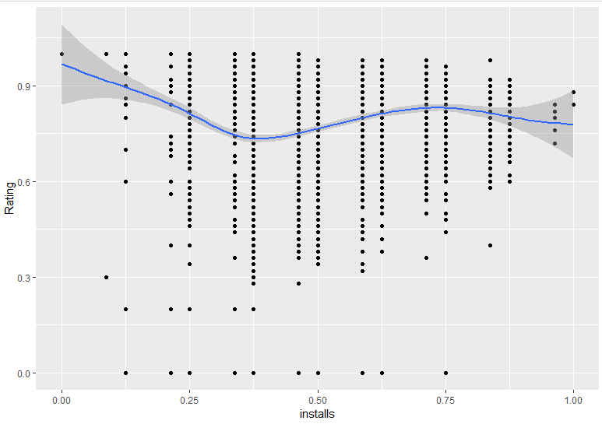
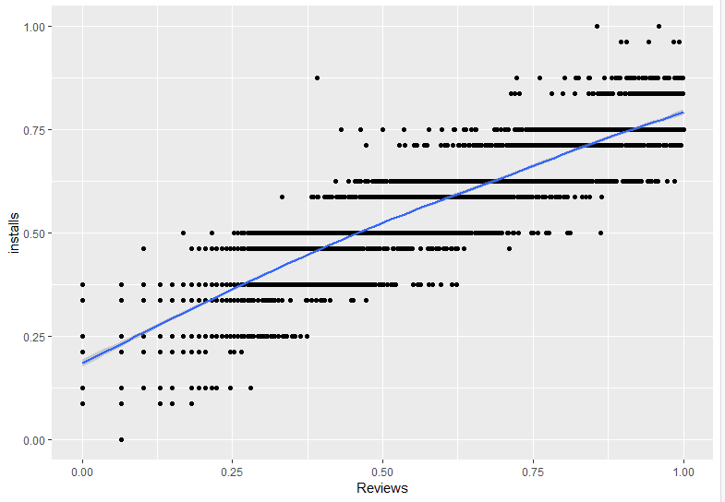
Linear Regression
Normalize the data
Make a Train and Test Sample from dataset

Slide 12
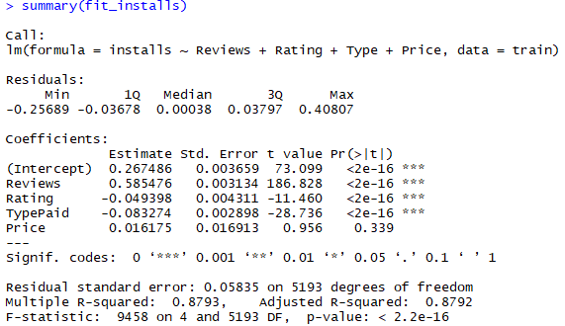
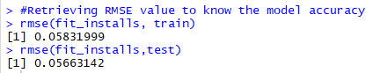
Linear regression (cont’d)

Slide 13
Summary and Conclusion
Dataset variables
Finding NaN and Outliers
Dataset cleaning
EDA
Clustering
Linear Regression
Analysis Questions
& Answers
Which application is going to be successful in future and worth to investigate on it?
Ans: Family (Cluster 6)
Centre of Rating Standard = 0.0224
Centre of Reviews Standard = -0.3674
Centre of installs Standard = -0.1963
Do the variables in our dataset impact the number of Installs for any application in Play store?
Ans: Yes, Model for Install is based on Review, Ratings, Type, and Price.
RMSE is 0.057 in the train sample and 0.058 in test sample.
Adjusted R Square 0.88 – close to 1

Slide 14
references
Alex Makarevich. (2018). Alternative Google Play app stores to consider. Retrieved from https://appdevelopermagazine.com/alternative-google-play-app-stores-to-consider/
Ben Popper. (2017). Google announces over 2 billion monthly active devices on Android. Retrieved from https://www.theverge.com/2017/5/17/15654454/android-reaches-2-billion-monthly-active-users
Statista. (2019). Number of apps available in leading app stores as of 1st quarter 2019. Retrieved from https://www.statista.com/statistics/276623/number-of-apps-available-in-leading-app-stores/

Slide 15
THANK YOU!

